Slide 1
LEARNING THEORY

Slide 2
Different Levels of Abstraction
Decision Functions
We don’t know the “right” levels of abstraction
So let the model figure it out!
Notes:
TODO: Make pixels greyscle
TODO: Increase size of 1st hidden layer

Slide 3
Different Levels of Abstraction
Decision Functions
Face Recognition:
Deep Network can build up increasingly higher levels of abstraction
Lines, parts, regions
Notes:
TODO: Make pixels greyscle
TODO: Increase size of 1st hidden layer

Slide 4
Different Levels of Abstraction
Decision Functions
Output
y
Hidden Layer 3
c₁
c₂
…
c_{F}
Hidden Layer 2
b₁
b₂
…
b_{E}
Hidden Layer 1
a₁
a₂
…
a_{D}
Input
x₁
x₂
x₃
…
x_{M}

Slide 5
Architectures

Slide 6
Neural Network Architectures
Even for a basic Neural Network, there are many design decisions to make:
# of hidden layers (depth)
# of units per hidden layer (width)
Type of activation function (nonlinearity)
Form of objective function

Slide 7
Activation Functions
Neural Network with sigmoid activation functions
Output
y
Hidden Layer
z₁
z₂
…
z_{D}
Input
x₁
x₂
x₃
…
x_{M}

Slide 8
Activation Functions
Neural Network with arbitrary nonlinear activation functions
Output
y
Hidden Layer
z₁
z₂
…
z_{D}
Input
x₁
x₂
x₃
…
x_{M}

Slide 9
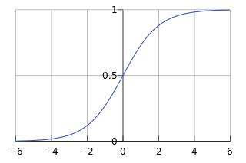
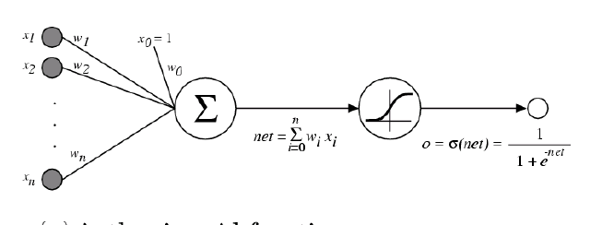
Activation Functions
Sigmoid / Logistic Function
So far, we’ve assumed that the activation function (nonlinearity) is always the sigmoid function…

Slide 10
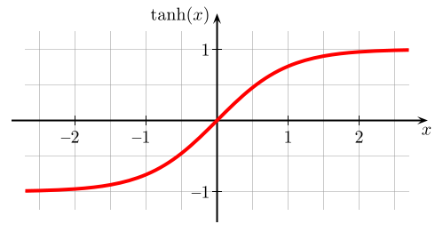
Activation Functions
A new change: modifying the nonlinearity
The logistic is not widely used in modern ANNs
Alternate 1: tanh
Like logistic function but shifted to range [-1, +1]
Slide from William Cohen

Slide 11
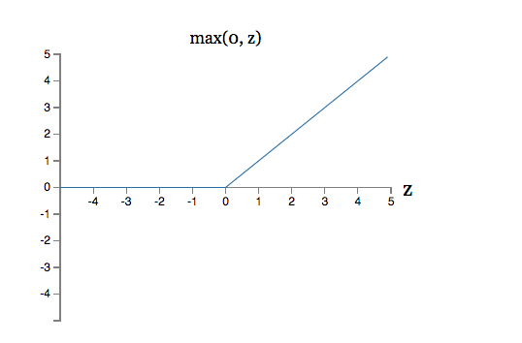

Activation Functions
A new change: modifying the nonlinearity
reLU often used in vision tasks
Alternate 2: rectified linear unit
Linear with a cutoff at zero
(Implementation: clip the gradient when you pass zero)
Slide from William Cohen

Slide 12
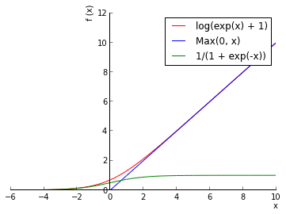
Activation Functions
A new change: modifying the nonlinearity
reLU often used in vision tasks
Alternate 2: rectified linear unit
Soft version: log(exp(x)+1)
Doesn’t saturate (at one end)
Sparsifies outputs
Helps with vanishing gradient
Slide from William Cohen

Slide 13
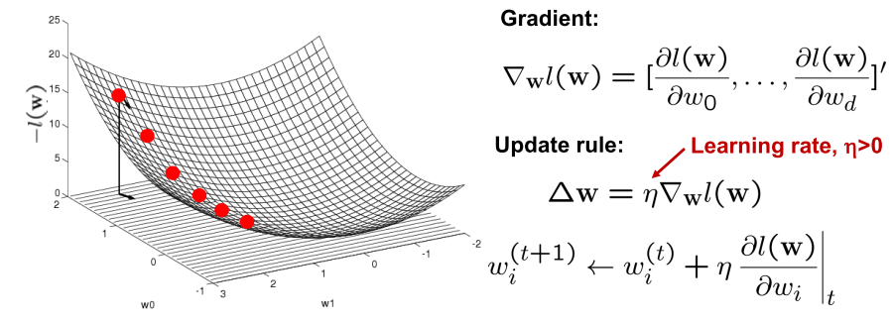
Optimizing concave/convex function
Maximum of a concave function = minimum of a convex function
Gradient ascent (concave) / Gradient descent (convex)
Gradient ascent rule

Slide 14
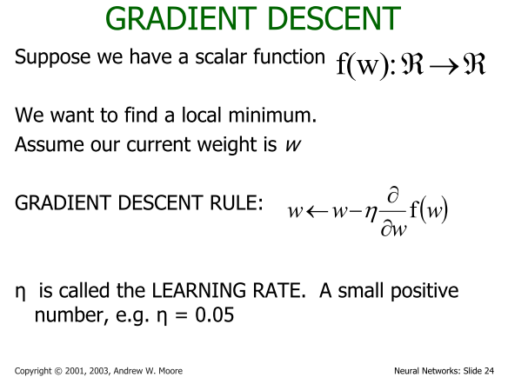

Slide 15
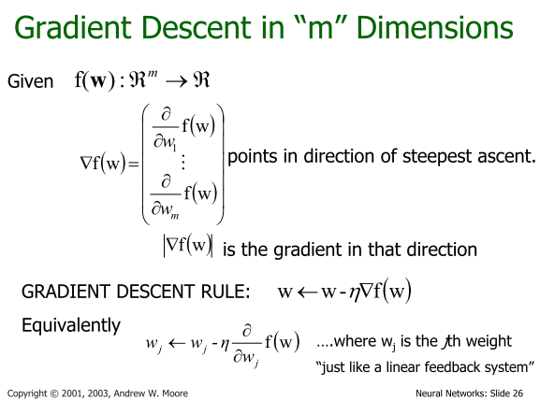

Slide 16
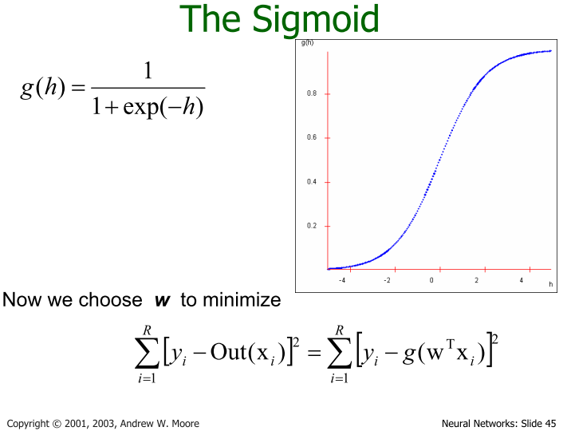

Slide 17
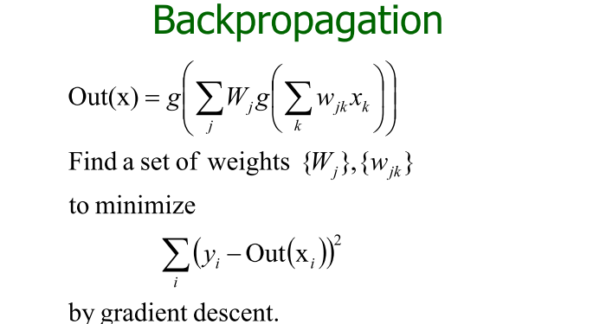

Slide 18
Backpropagation
Iteratively process a set of training tuples & compare the network's prediction with the actual known target value
For each training tuple, the weights are modified to minimize the mean squared error between the network's prediction and the actual target value
Modifications are made in the “backwards” direction: from the output layer, through each hidden layer down to the first hidden layer, hence “backpropagation”
Steps
Initialize weights (to small random #s) and biases in the network
Propagate the inputs forward (by applying activation function)
Backpropagate the error (by updating weights and biases)
Terminating condition (when error is very small, etc.)
18
Notes:
18

Slide 19
Neural Network as a Classifier
Weakness
Long training time
Require a number of parameters typically best determined empirically, e.g., the network topology or “structure.”
Poor interpretability: Difficult to interpret the symbolic meaning behind the learned weights and of “hidden units” in the network
Strength
High tolerance to noisy data
Ability to classify untrained patterns
Well-suited for continuous-valued inputs and outputs
Successful on a wide array of real-world data
Algorithms are inherently parallel
Techniques have recently been developed for the extraction of rules from trained neural networks
19
Notes:
19

